Slide 1
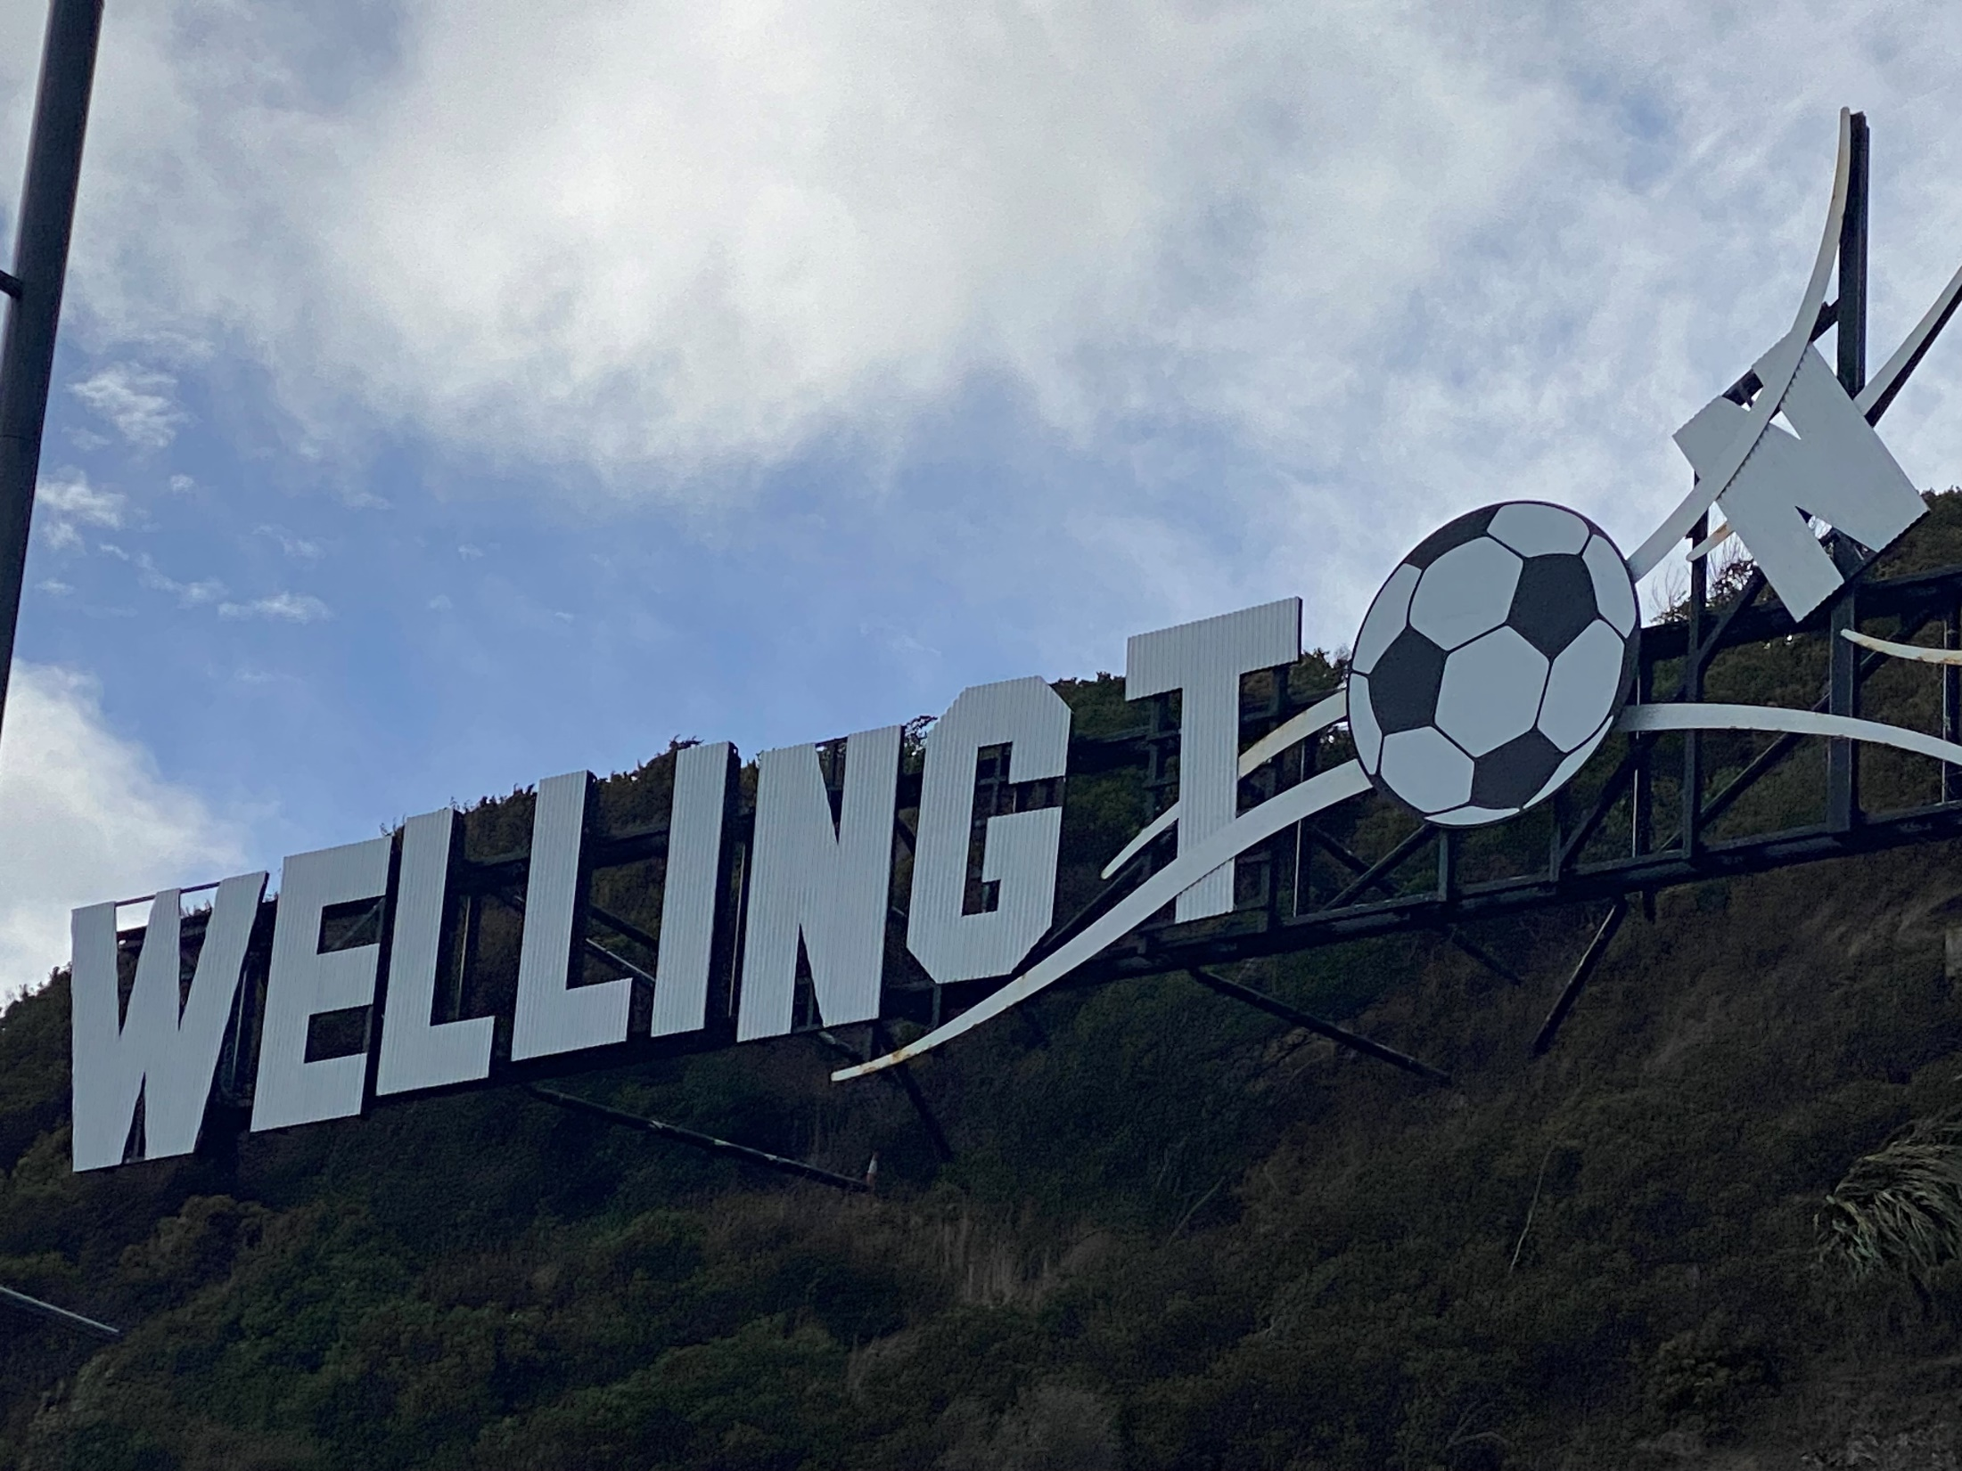

8th May, 2024
Haere Mai & Welcome to the
Wellington Region
HEALTH NEW ZEALAND
Te Whatu Ora
Capital, Coast, Hutt Valley and Wairarapa
Wellington Regional, Kenepuru Community, Hutt Valley and Wairarapa Hospitals

Slide 2
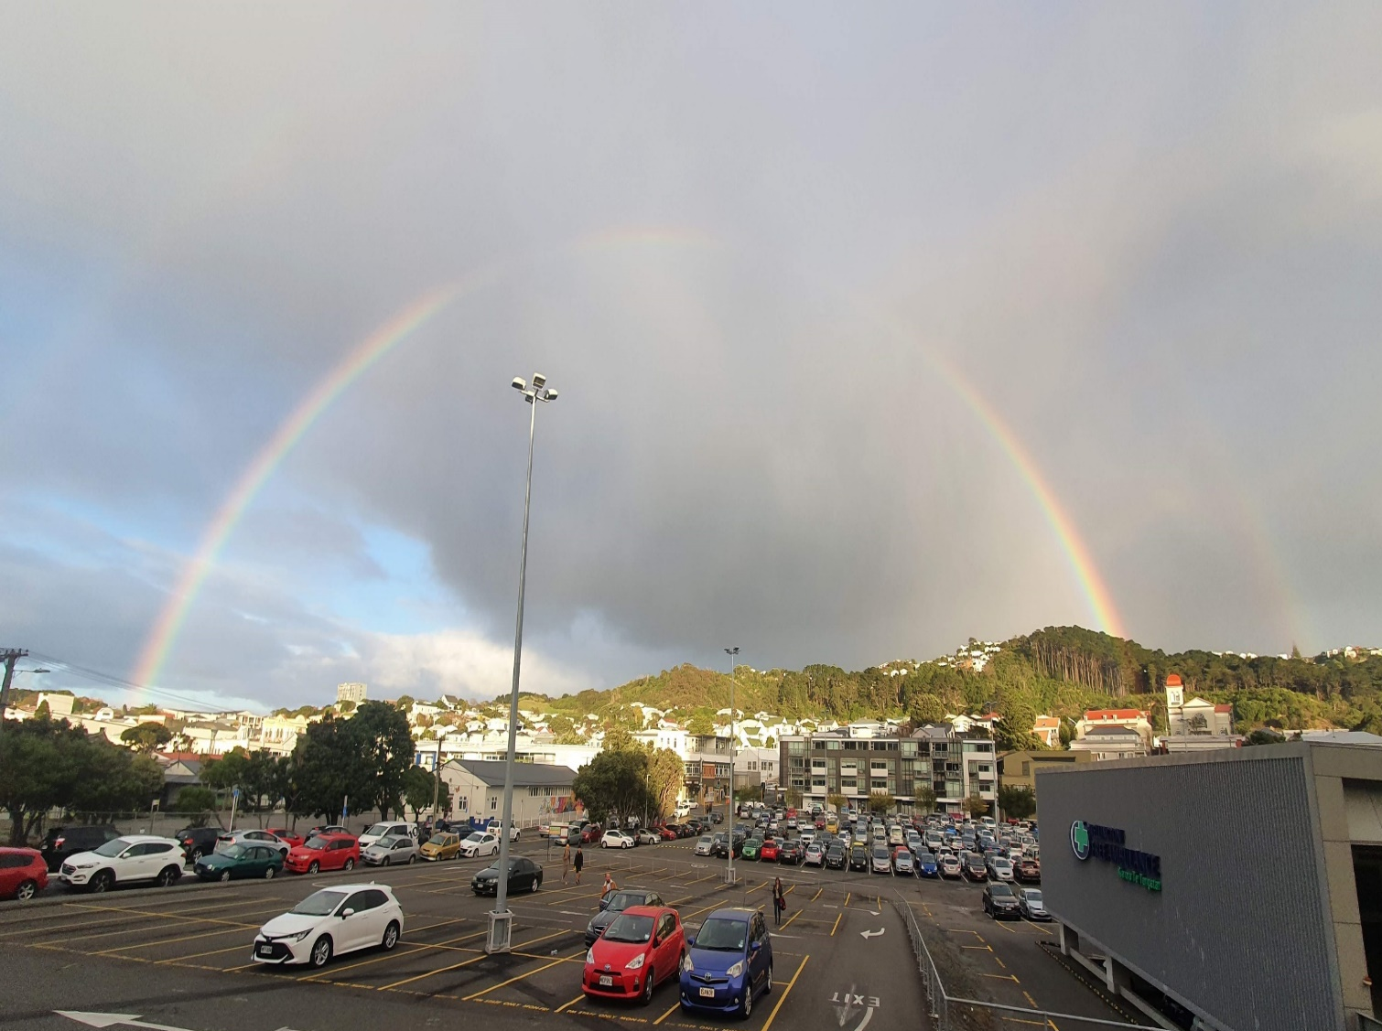
AGENDA
1. Introduction to the panel (Slide 3)
2. Meet the rest of the RMO team (Slide 4)
Wellington region ‘Fast facts’:
~Wellington, Hutt Valley & Wairarapa (Slides 5 to 7)
4. Why work in our region? (Slide 8)
5. District RMO Units and what we offer (Slide 9)
6. Meet two of our doctors- PGY1 & PGY2 (Slide 10/video)
7. RUN options (Slide 11)
8. Weekly teaching (Slide 12)
9. How to get a job here (Slide 13)
Application process & selection criteria (Slide 14)
Summary (Slide 15)
12. Photo/Video credits (Slide 16)

Slide 3
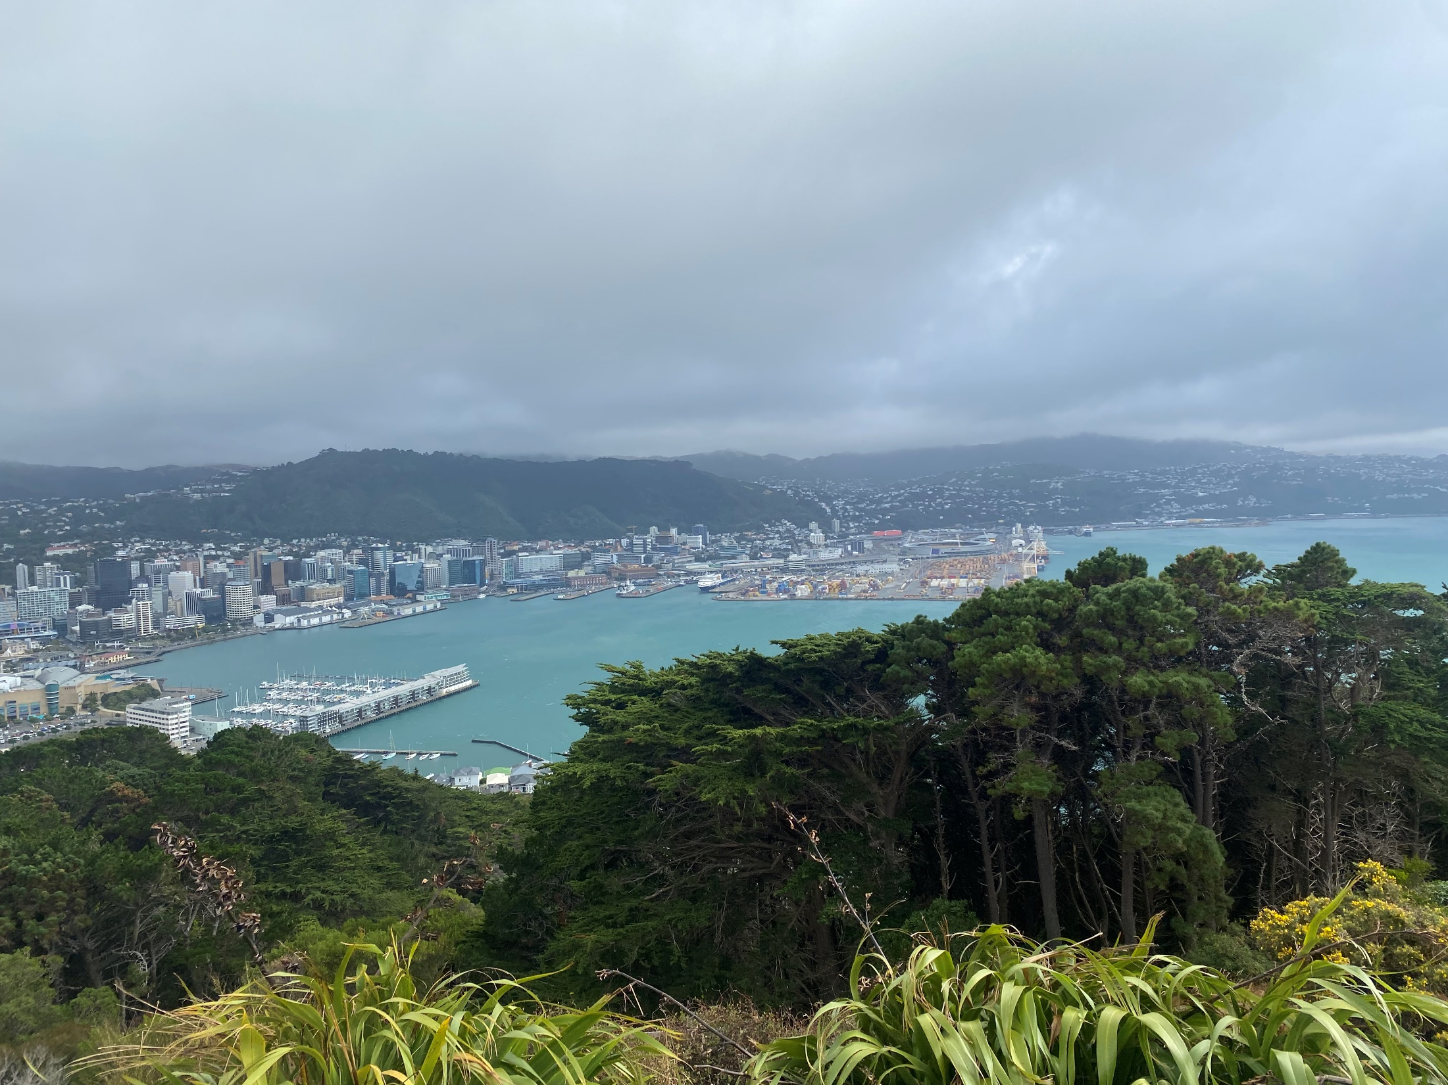
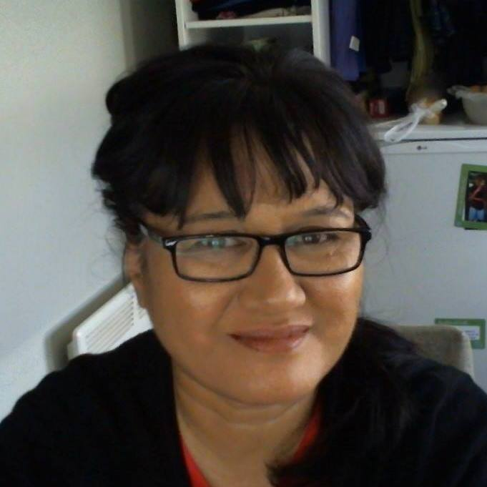
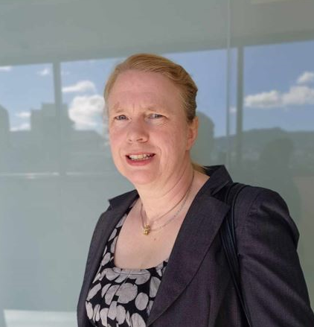

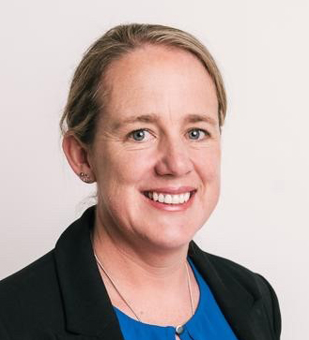
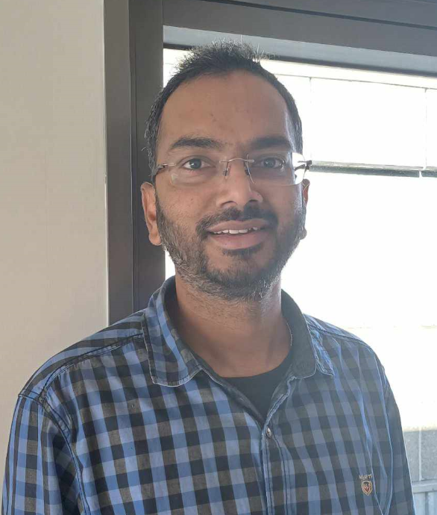
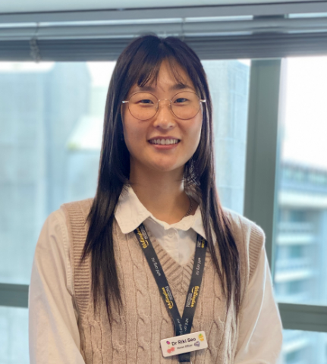
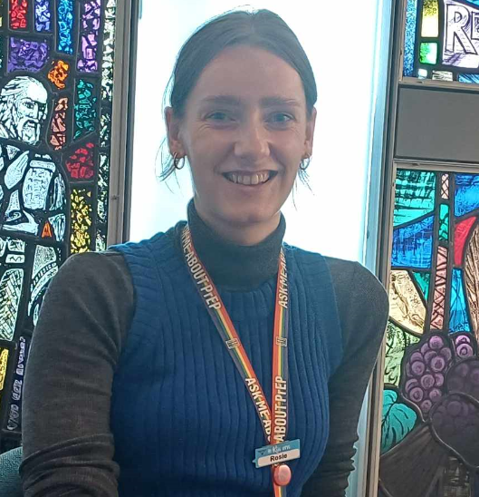
YOUR PANEL
Operations Manager RMO Unit District Pauline Bennett-Tamati
Clinical Leader RMO Unit Dr Christine Mouat
Pre-vocational Education Supervisor Dr. Alice Stringer
RMO Recruitment Advisor Sid Kadukuntla
Current PGY1 Dr. Riki Seo
Current PGY2 Dr. Rosie Schulz

Slide 4
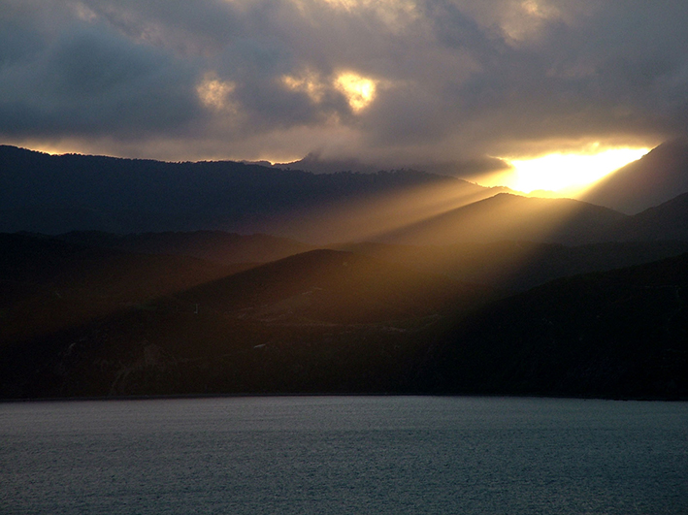
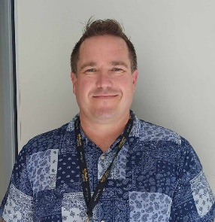
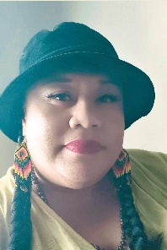
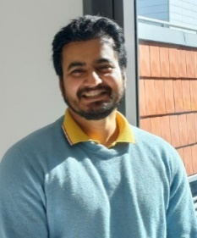
Meet the rest of the RMO recruitment team
RMO Recruitment Advisor Bernard Frey
RMO Recruitment Nia Bartley
RMO Candidate Care Co-ordinator Sumit Tiwari

Slide 5
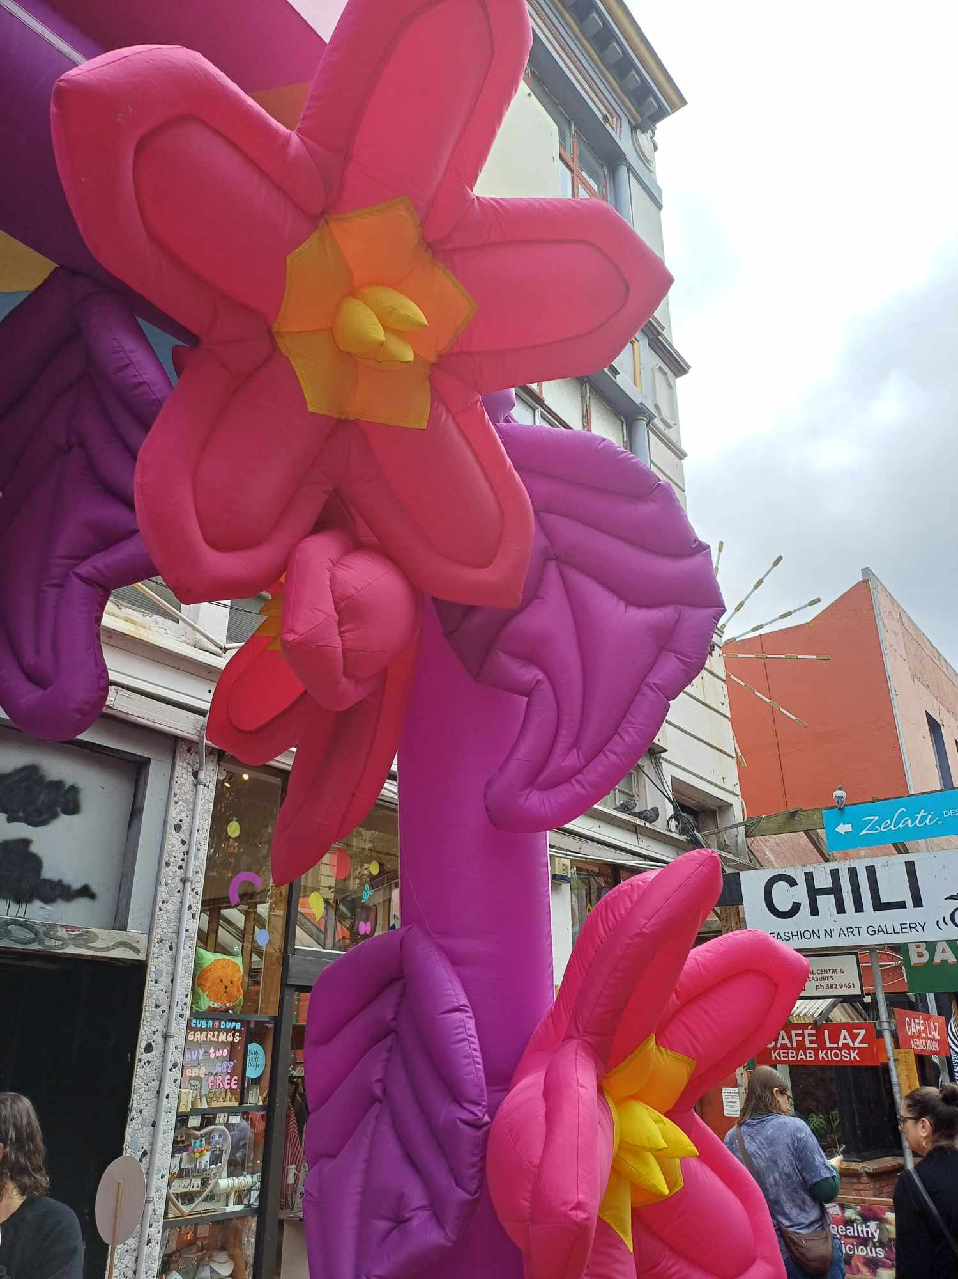
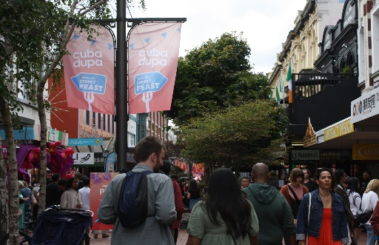
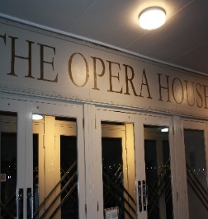
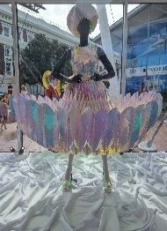
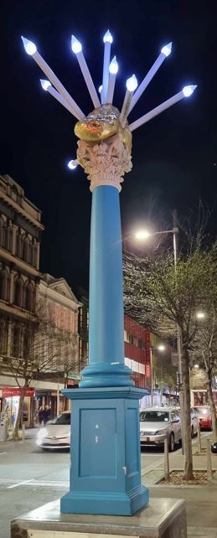
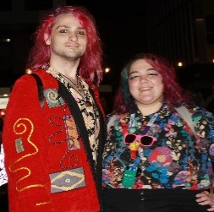

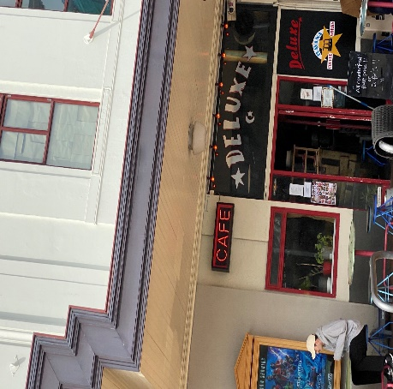
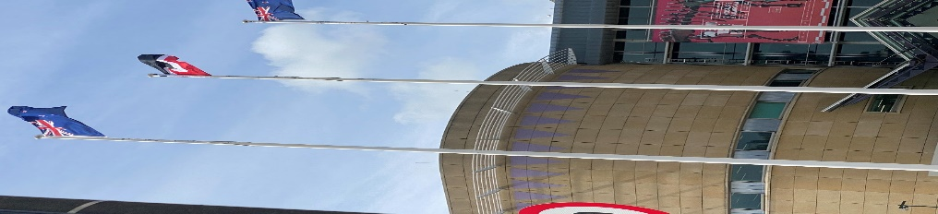
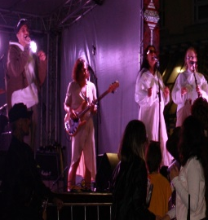
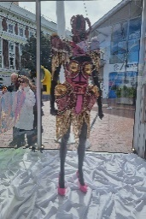
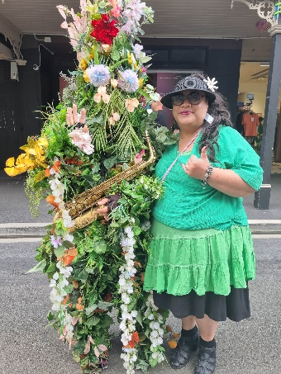
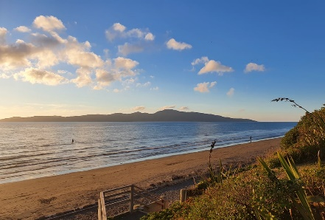
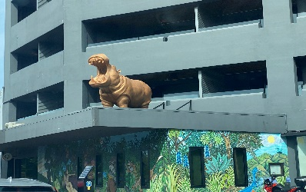

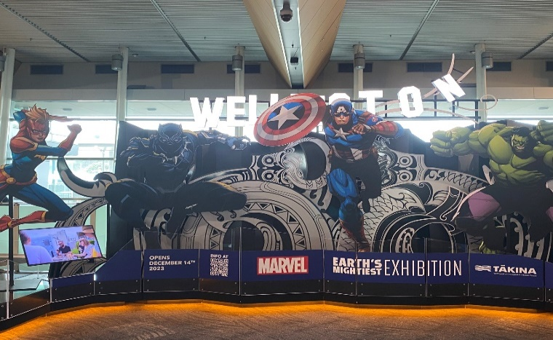
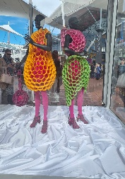
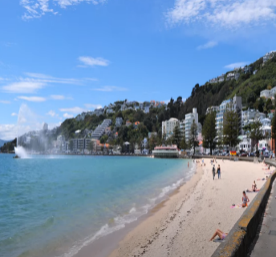
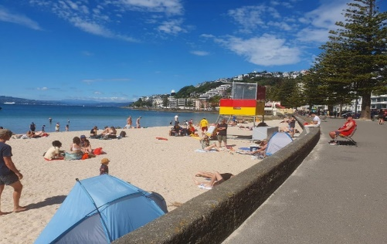
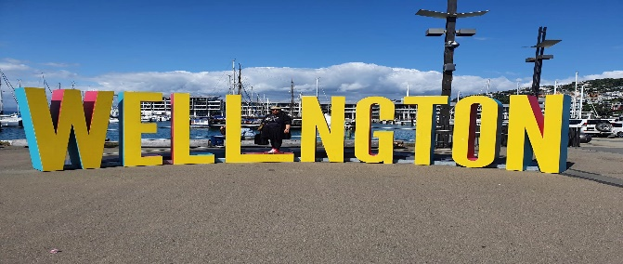
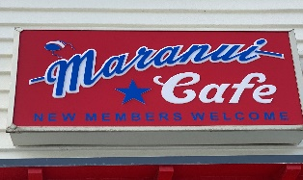
WELLINGTON REGION Te whanganui-a-Tara
‘Fast Facts’
Wellington
Multiple cafes & restaurants
More coffee shops per capita than New York!
Walking trails close to the city
Zealandia
Art & Culture
Museum of NZ Te Papa Tongareva (Te Papa)
WOW (World of wearable Arts)
Home of NZSO
Live theatre/comedy
WETA workshop
Festivals
Surfing

Slide 6
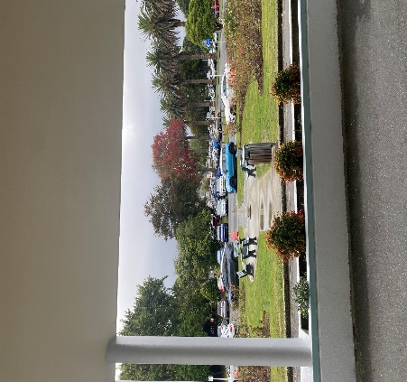
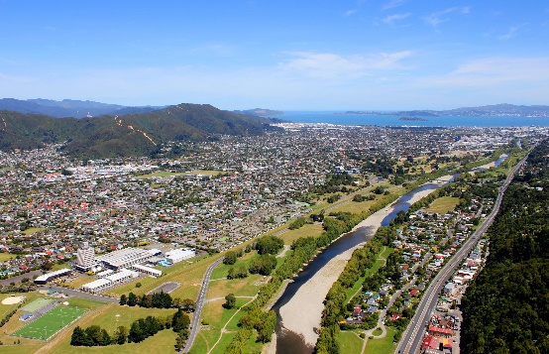
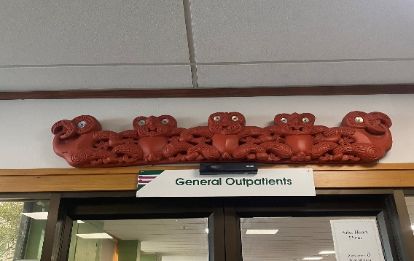
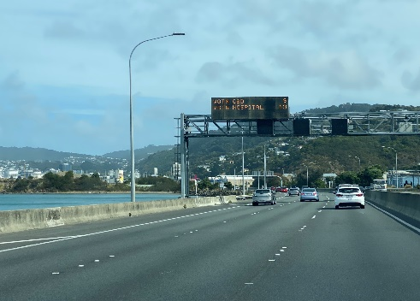
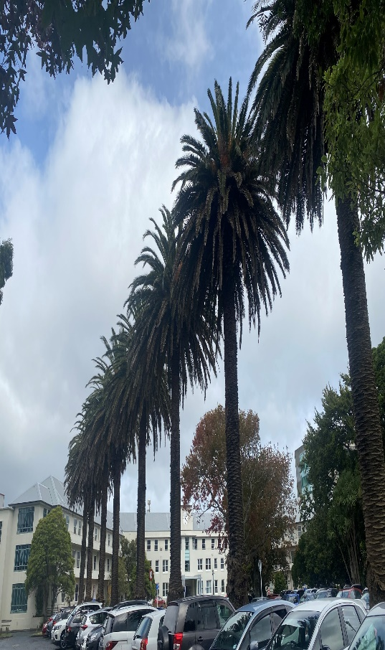
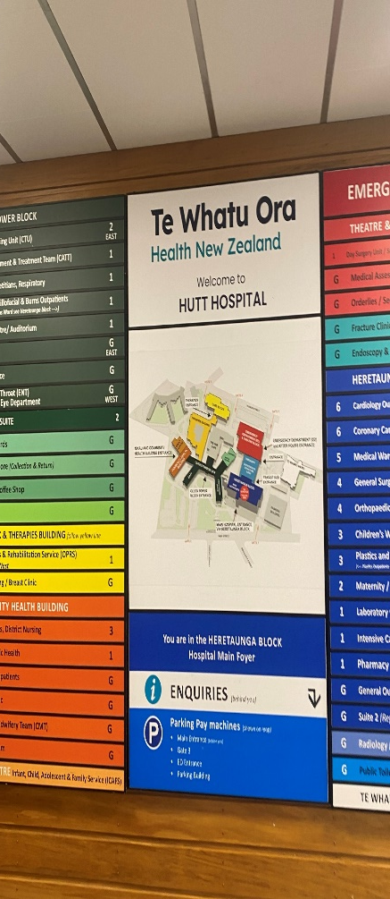
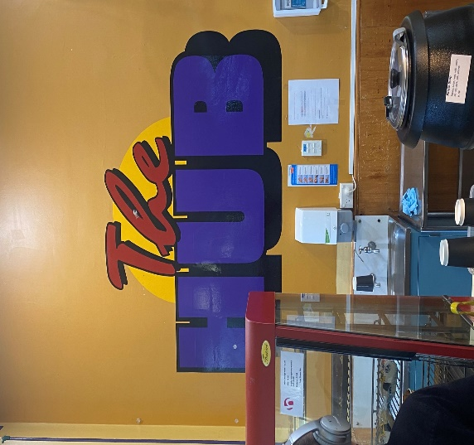
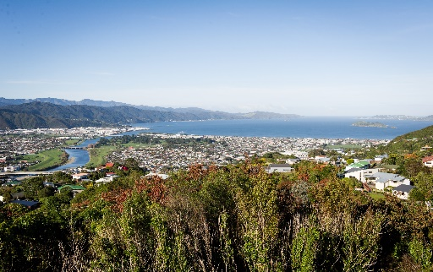
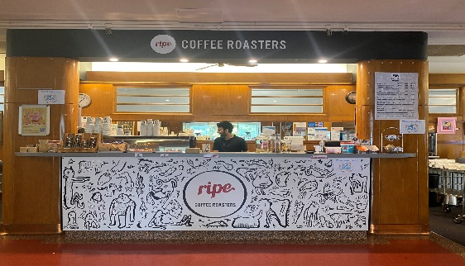
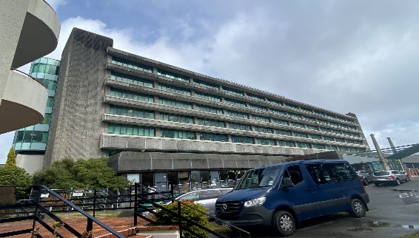
Hutt Valley
WELLINGTON REGION Te whanganui-a-Tara
‘Fast Facts’
  Lower Hutt & Upper Hutt
  Petone – restaurant heart of the valley
  Beaches, seaside communities
  Art Museums, live theatre.
  20 minutes from central Wellington.
  Great shopping!

Slide 7
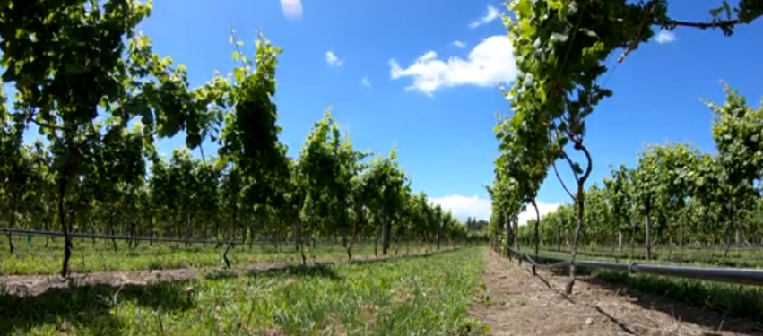
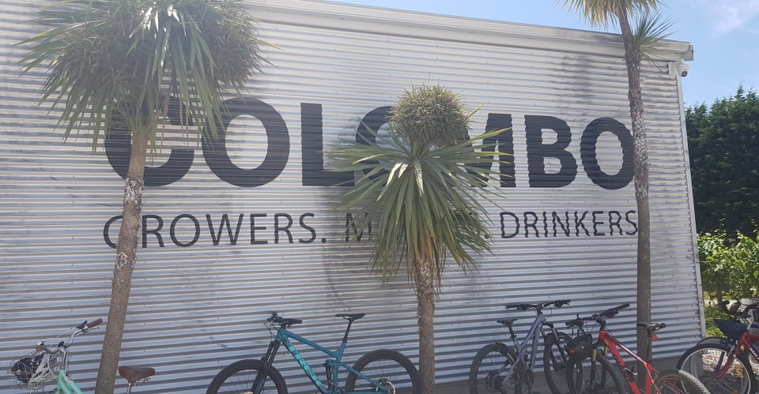
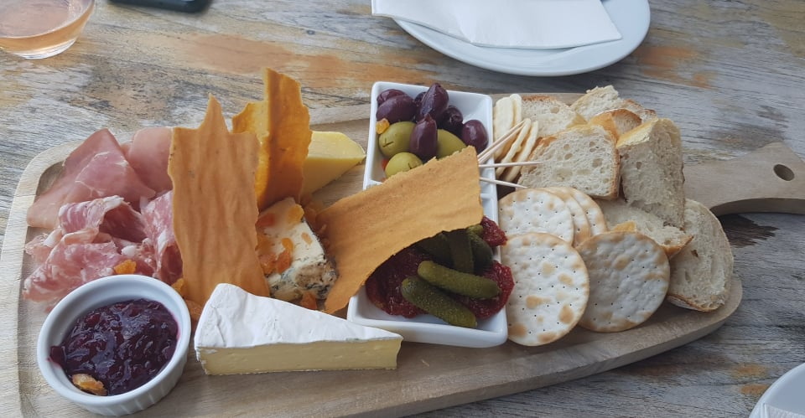
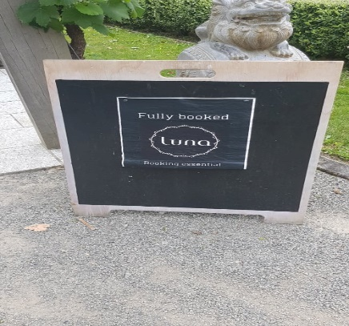
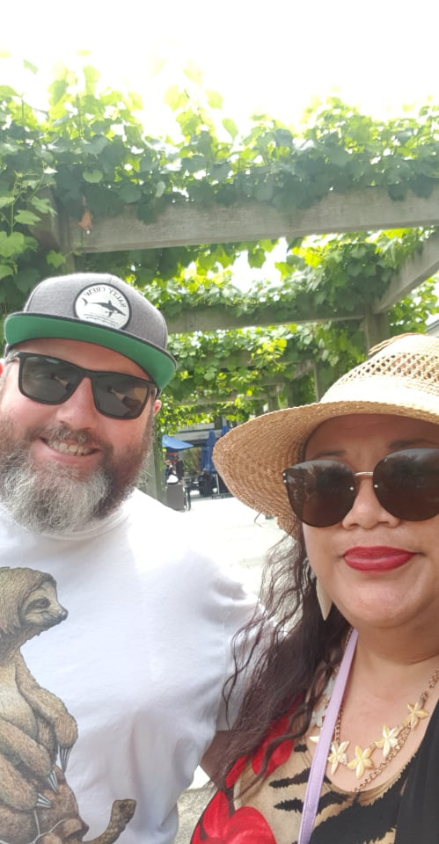
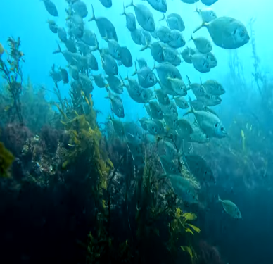
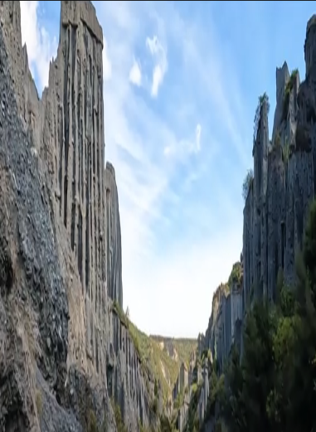
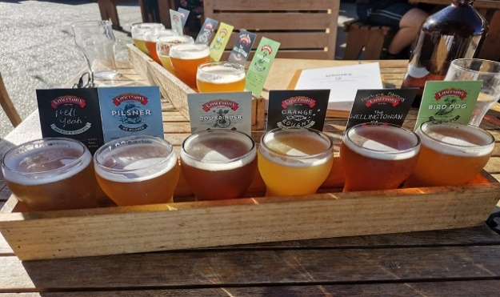


Wairarapa
WELLINGTON REGION Te whanganui-a-Tara
‘Fast Facts
Heart of the wine region
Vineyard cafes & Olive groves
Cycling
Small towns full of character
Dark sky region – best star constellations can be seen here

Slide 8















Why work in Wellington?
Opportunity to work in five different busy hospitals
Tertiary services
Secondary services
Community/rural services
Robust medical supervision
Simulation Suite
Well structured and planned post-graduate training for PGY1 House Officers.
Ability to complete your entire training in the region. Close association with the Otago School of Medicine campus (next to Wellington Hospital) with access to library and research supports)
Electronic tools to improve workflow and communication MedApp.

Slide 9




District RMO Units
– What we offer
RMO recruitment across the region
We employ over 600 RMOs across the region annually
Manage the ACE programme & selection of PGY1 RMO Unit at each hospital
Rostering – House Officers & Registrars
* General Medicine
* General Surgery
Manage leave & relief pools

Slide 10

Meet PGY1
Dr.Riki Seo
&
PGY2
Dr Rosie Schulz
(video to follow)

Slide 11



RUN Options
1st YEAR
2ND YEAR
Cardiology
Cardiothoracic
ENT
Gastroenterology
Medicine
Neurosurgery
Obstetrics & Gynaecology
Orthopaedics
Plastics
Psychiatry
Rehabilitation
Renal
Respiratory
Stroke/Rehab
Surgery
Upper GI/HPB
Gen/Colorectal
Urology
Vascular Surgery
Anaesthetics
Community-based attachments:
Palliative care/Hospice
Public Health
GP
Community Geriatrics
Addictions
ED
Haematology
ICU
Neurology
Oncology
Obstetrics & Gynaecology:
Diploma option
Paediatrics:
Diploma option
Psychiatry
Reliever runs
Rheumatology

Slide 12



Weekly Teaching
Protected teaching time is provided weekly at all hospitals. Zoom option is available, if you’re unable to attend in person as you are working off-site
Weekly teaching session on a Tuesday afternoon for Wellington, Kenepuru, Hutt & Wairarapa: 1230-1330
ALERT course
CORE – Certificate of Resuscitation & Emergency Care
Apart from the above, we offer specific hospital teaching sessions as follows:
Wellington Hospital hosts a teaching session on Wednesday afternoon: 13:00-14:00
Kenepuru Hospital organises teaching sessions as below:
Monday Lunch time – Departmental meetings
Wednesday – lunch time
Friday – Journal club/Radiology meeting
Hutt Valley Hospital provides a comprehensive teaching session on Friday morning: 08:15-09:15
Wairarapa Hospital's protected teaching times are scheduled as follows:
Wednesday lunchtime: 12:00-13:00 andThursday Journal Club: 12:00-13:00
Eg. Specialty specific teaching example in Wellington
Emergency Dept Thursday 9 – 11am
General Medicine Monday 12.30 – 1.30pm & Thursday 12.30 – 1.30pm
Respiratory Tuesday 11am – 12pm
Cardiology Tuesday 12.30 – 1.30pm
Ear Nose & Throat Friday afternoon
Vascular Surgery Tuesday morning
General Surgery Friday morning
Haematology Journal Club Tuesday 10.30am,
Teaching Friday 12.30pm
Oncology Friday 8am
Neurology Friday 9.30am
Capital, Coast & Hutt Valley District Hospitals provide an extensive list of additional work based teaching and training that is available to all CCHV employees through the ‘ConnectMe’ application. This includes, but is not limited to:
Tikanga Maori
Open communication
Understanding bias in health care

Slide 13




How to get a job here
Complete expression of interest survey in full:
This will get you a telephone interview
Complete your ACE application fully:
We score:
  Interview
  Cover letter/personal statement
  Your connections in the Wellington region
  CV
  References
  We want happy, successful, progressive,
  interesting colleagues
  for our region, our future.

Slide 14



Application process
Complete online expression of interest for a telephone interview
https://forms.office.com/r/PnmftCif37
Cover letter to include:
Reasons why you want to come to the region
Family and friends in the region
Sporting, community or cultural involvements
Training opportunities
Willingness to work in all 3 regional hospitals – Wellington, Hutt Valley and Wairarapa
Full CV or resume to include:
Personal statement
Scholarships
Leadership positions
Academic achievements: prizes, awards, academic transcript
3 References – very important, must be current, do not leave these to the last minute, talk with your referees early.

Slide 15



See you next year, this could be you......

Slide 16

Photo/Video Credits
Dave Brett – West Coast sunset Kapiti Photos & videos
Dr Riki Seo – Personal Photos
Dr Rosie Schulz – Personal Photos
Nia Bartley & Sid Kadukuntla – Pics & video footage around Wellington region~Wellington CBD, Porirua, Hutt Valley; Video interviews & photos of Dr.Riki Seo & Dr. Rosie Schulz.
Nia Bartley – Footage of festivals; Video interview of Pauline Bennett-Tamati &
video interview & photo of Dr. Christine Mouat
Ryan McMaster – Wairarapa Photos
Stock pics from 2023
Richard Latty from the Comms team ~ who helped edit our videos & final presentation.
We would like to thank all of our panel:
Pauline Bennett-Tamati, Dr. Christine Mouat, Dr Alice Stringer, Dr Riki Seo, Dr Rosie Schulz & Sid Kadukuntla
(And Bernard Frey, Nia Bartley & Sumit Tiwari) & YOU – our viewer.

